Slide 1


Dynamic PM&PLM checklist
GIT El Salvador

Slide 2
Mobile
Mateline

Slide 3
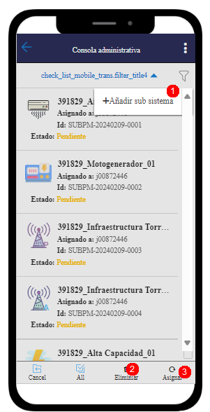
Main checklist page
Form list: list of the created forms
1 Add new form: create and relate forms to the curren WO
2 Delete form: delete a form from the list
3 Reassign form: reassign form to another FME

Slide 4
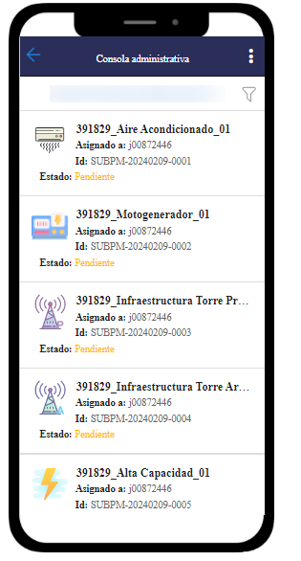
Form list
Aire Acondicionado
Alta Capacidad
Infraestructura Torre Arrendada
Infraestructura Torre Propia
Moto generador
Tecnologias

Slide 5
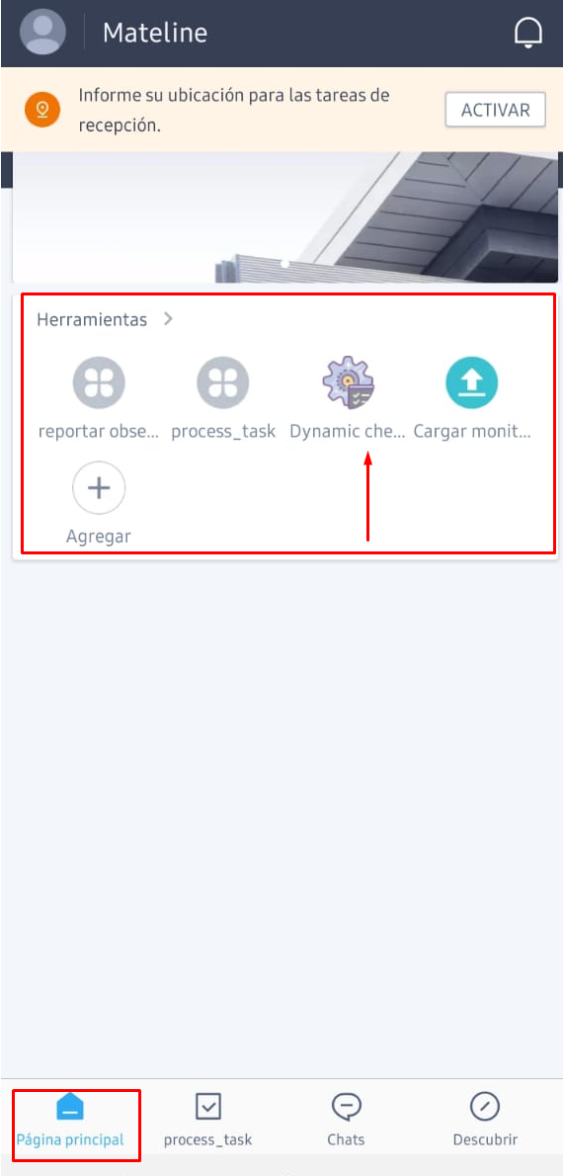

Form Design
The app can be accesible from mateline home
Every FME can be the Work Orders that have almost one form assigned
Every form category have different Mateline page
The form could have Dynamic ítem list in case is needed
Task Info is filled automatically

Slide 6
PC page configuration

Slide 7
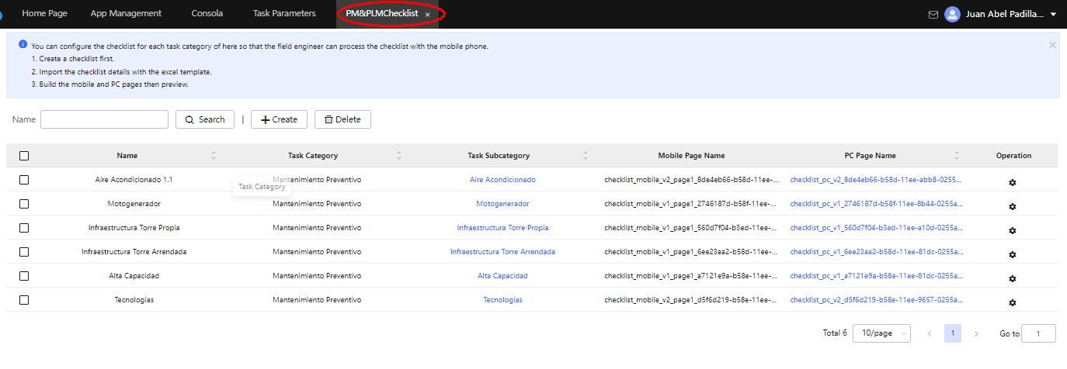
Upload checklist

Slide 8
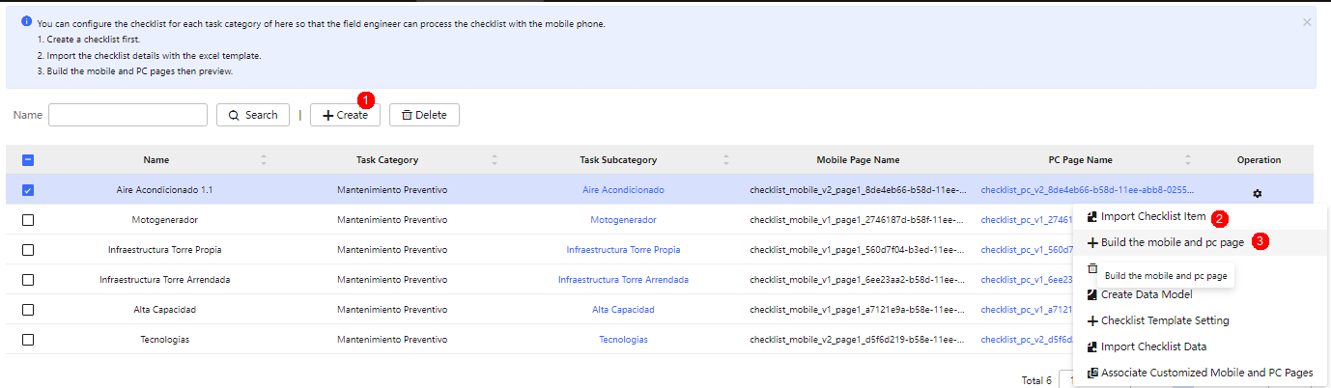
Building checklists
1.- Create checklist
2.- Upload checklist fields
3.- Build pages

Slide 9
PDF report build
Web report

Slide 10
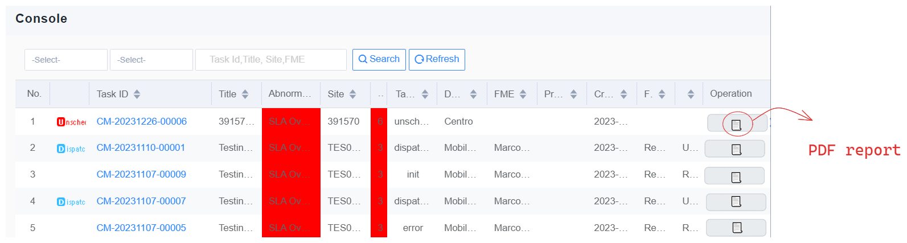
PDF web
After work order completion web users can query reports and generate PDF web report

Slide 11
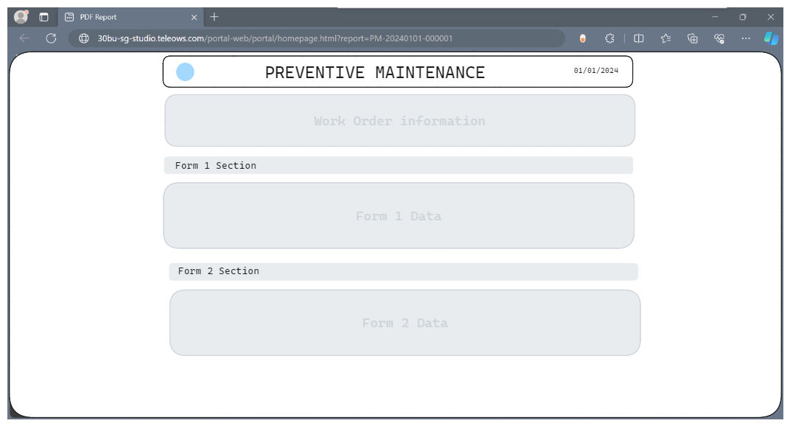
PDF web
The web report is displayed and can be printed

Slide 12
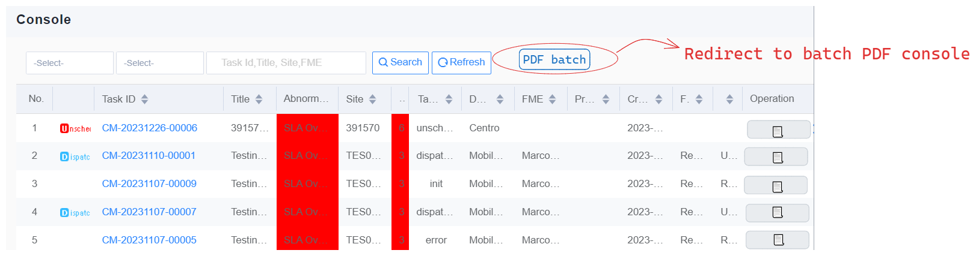
Pendiente PDF report batch download
Several PDFs can be queued to generate in batch

Slide 13
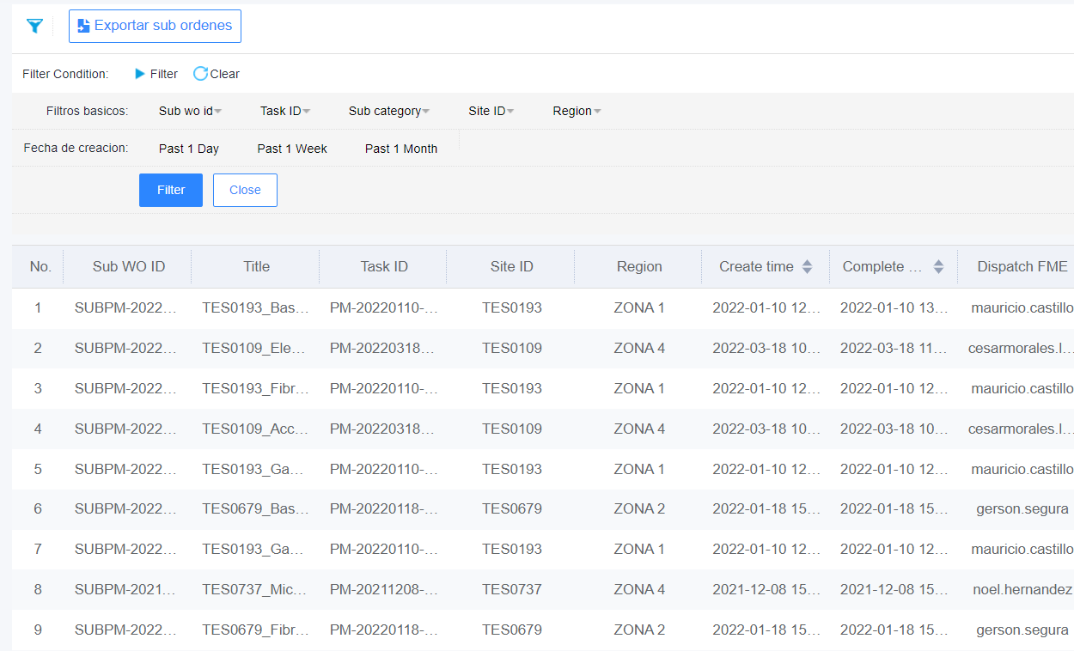
Pendiente Build sub ticket consoles
Sub tickets can be queried and exported in console

Slide 14
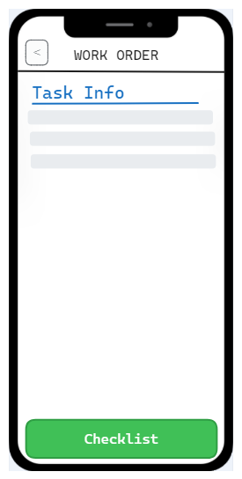
Mobile page integration
A button to go to checklist page is available after the FME arrive and enter to the site
Apply for PM&PLM

Slide 15

Mobile page integration
Only after the FME complete the checklist information of all forms the task can be completed and closed

Slide 16
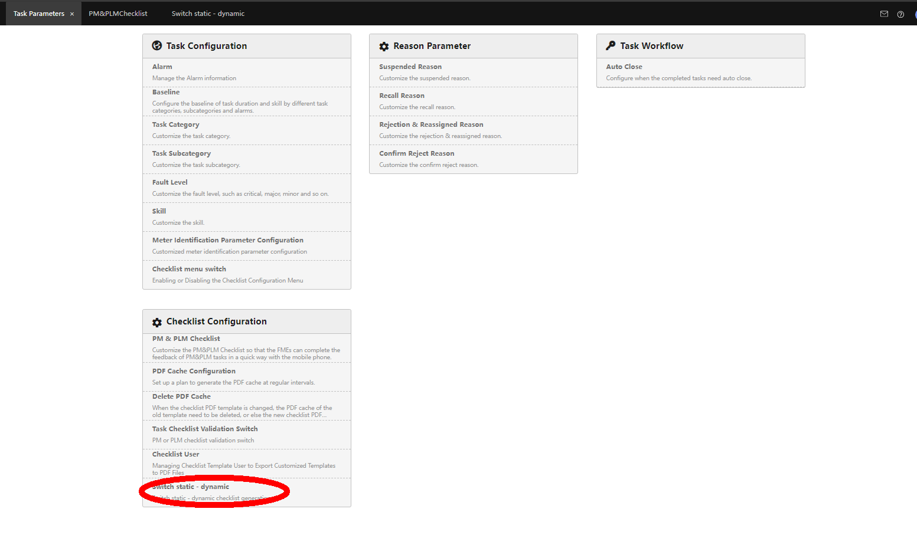
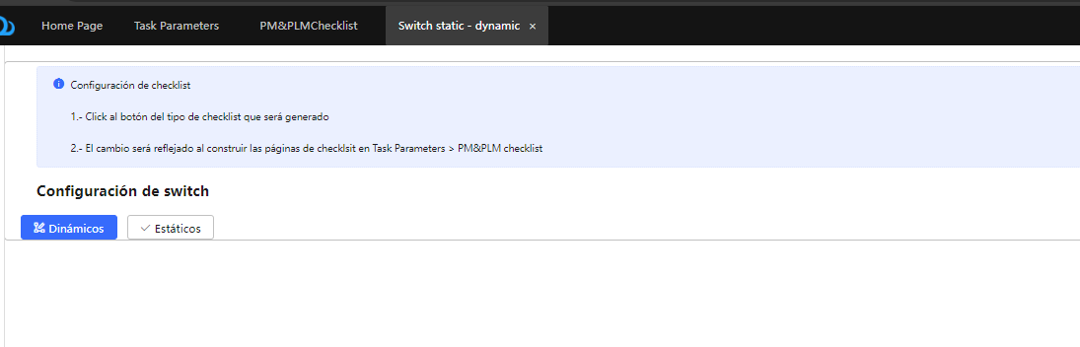
Switch Dynamic / static

Slide 17
Work Plan
Task | Duration
Design | 5
Mobile development | 5
Web development | 5
Export functions | 5
Test | 1
Deploy | 1

Slide 18



Copyright©2014 Huawei Technologies Co., Ltd. All Rights Reserved.
The information in this document may contain predictive statements including, without limitation, statements regarding the future financial and operating results, future product portfolio, new technology, etc. There are a number of factors that could cause actual results and developments to differ materially from those expressed or implied in the predictive statements. Therefore, such information is provided for reference purpose only and constitutes neither an offer nor an acceptance. Huawei may change the information at any time without notice.

